Slide 1
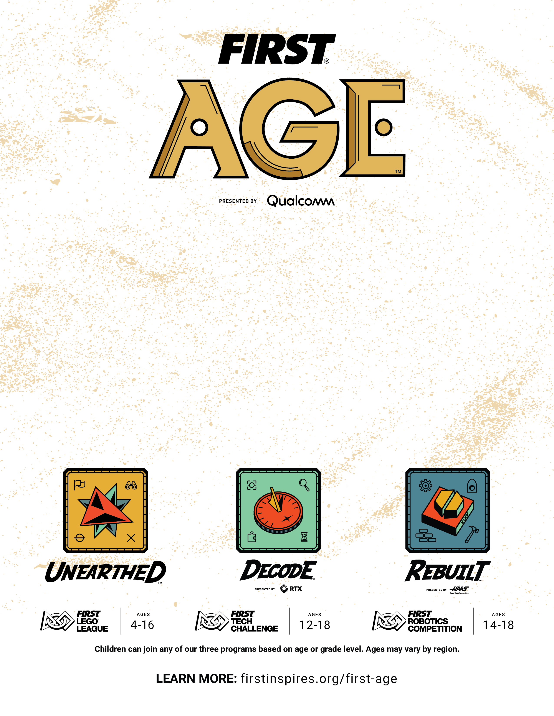
Uncover The Future
FIRST® is the sport where every kid can go pro. As the world's leading non-profit that prepares young people for the future, FIRST® offers a suite of life-changing youth robotics programs that build skills, confidence, and resilience. Participants work collaboratively to solve an annual, themed robotics challenge.
Every artifact we uncover holds a story. Each tool, each innovation, each work of art connects us to the people and ideas that came before us. Using STEM skills and teamwork, today we can dig deeper into discoveries than ever before.
Welcome to FIRST® AGETM presented by Qualcomm, our 2025-2026 robotics season inspired by archaeology. What will you uncover? Join us for an experience for the ages.

Slide 2
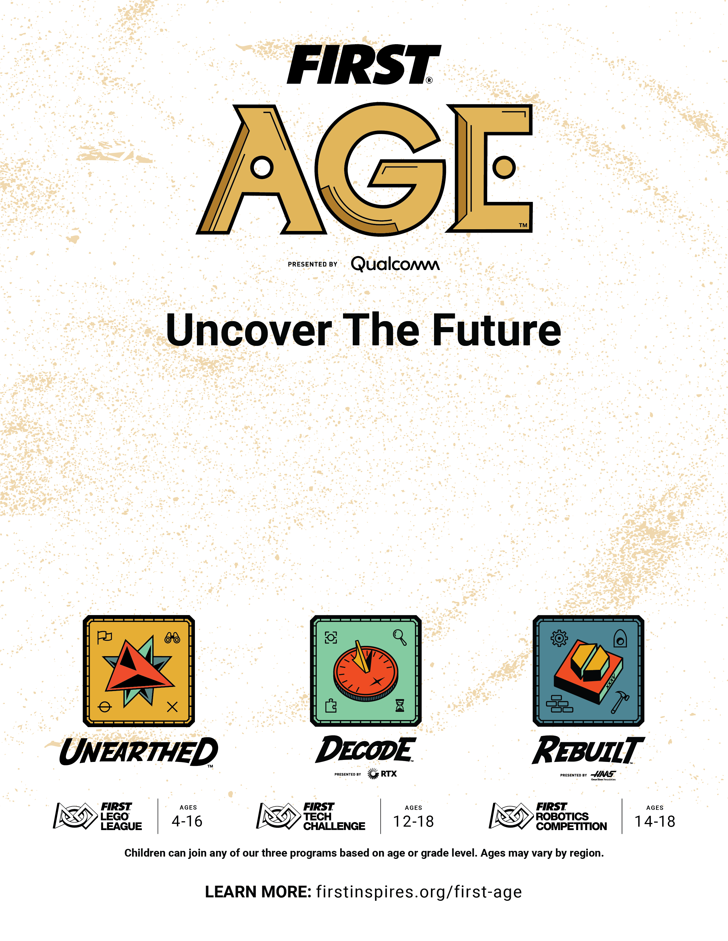
FIRST® is the sport where every kid can go pro. As the world's leading non-profit that prepares young people for the future, FIRST® offers a suite of life-changing youth robotics programs that build skills, confidence, and resilience. Participants work collaboratively to solve an annual, themed robotics challenge.
Every artifact we uncover holds a story. Each tool, each innovation, each work of art connects us to the people and ideas that came before us. Using STEM skills and teamwork, today we can dig deeper into discoveries than ever before.
Welcome to FIRST® AGETM presented by Qualcomm, our 2025-2026 robotics season inspired by archaeology. What will you uncover? Join us for an experience for the ages.

